Slide 1
ECEG-5193: Algorithm Analysis and Design
Algorithms of Graph Problems
Bipartite Graphs

Slide 2
Maximum Flow
Flow Networks

Slide 3
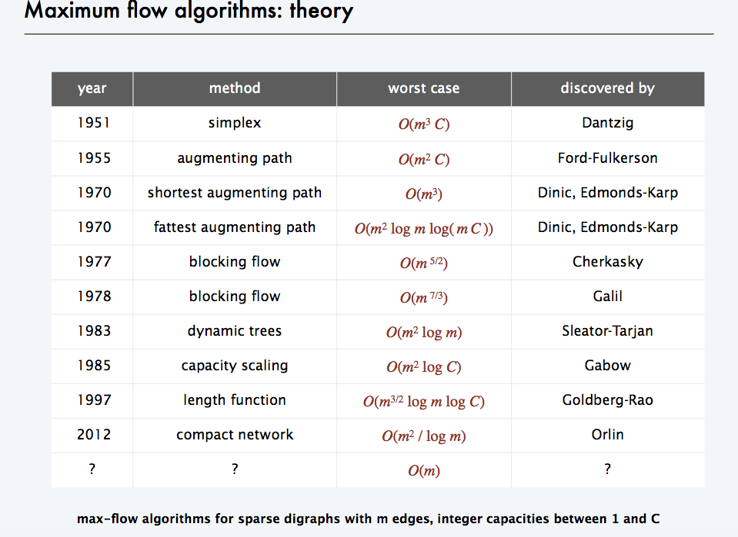

Slide 4
Bipartite Graph
A bipartite graph is an undirected graph G=(V,E) in which V can be partitioned into two sets V₁ and V₂ such that (u,v) ∈ E implies either u ∈ V₁ and v ∈ V₁₂ or vice versa.
That is, all edges go between the two sets V₁ and V₂ and not within V₁ and V₂.

Slide 5
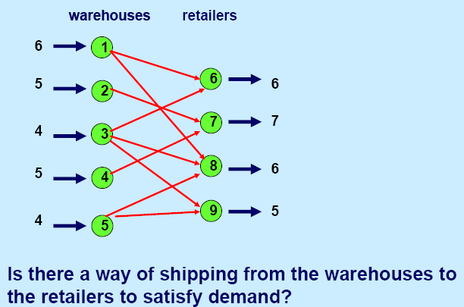
Application – Bipartite Matching

Slide 6
Application – Bipartite Matching
Example – given a community with n men and m women
Assume we have a way to determine which couples (man/woman) are compatible for marriage
E.g. (Joe, Susan) or (Fred, Susan) but not (Frank, Susan)
Problem: Maximize the number of marriages
No polygamy allowed
Can solve this problem by creating a flow network out of a bipartite graph

Slide 7
Model for Matching Problem
❍

Example:
Matching a Person with a book that he/she prefers to take.
⓪

③

②

①

Notes:
⓪①②③

Slide 8
Model for Matching Problem
❍

Example:
Matching a Person with a book that he/she prefers to take.
⓪

③

②

①

Notes:
⓪①②③

Slide 9
Model for Matching Problem
❍

Example:
Matching a Person with a book that he/she prefers to take.
⓪

③

②

Let’s try
Greedy
①

Notes:
⓪①②③

Slide 10
Model for Matching Problem
❍

Example:
Matching a Person with a book that he/she prefers to take.
⓪

③

②

Let’s try
Greedy
①

Notes:
⓪①②③

Slide 11
Model for Matching Problem
❍

Example:
Matching a Person with a book that he/she prefers to take.
⓪

③

②

Let’s try
Greedy
①

Notes:
⓪①②③

Slide 12
Model for Matching Problem
❍

Example:
Matching a Person with a book that he/she prefers to take.
⓪

③

②

Let’s try
Greedy
①

Notes:
⓪①②③

Slide 13
Model for Matching Problem
❍

Example:
Matching a Person with a book that he/she prefers to take.
⓪

③

②

Let’s try
Greedy
①

Notes:
⓪①②③

Slide 14
Model for Matching Problem
❍

Example:
Matching a Person with a book that he/she prefers to take.
⓪

③

②

Let’s try
Greedy
①

Notes:
⓪①②③

Slide 15
Model for Matching Problem
❍

Example:
Matching a Person with a book that he/she prefers to take.
⓪

③

②

Let’s try
Greedy
①

Notes:
⓪①②③

Slide 16
Model for Matching Problem
❍

Example:
Matching a Person with a book that he/she prefers to take.
⓪

③

②

Let’s try
Greedy
①

Notes:
⓪①②③

Slide 17
Model for Matching Problem
❍

Example:
Matching a Person with a book that he/she prefers to take.
⓪

③

②

Let’s try
Greedy
①

Notes:
⓪①②③

Slide 18
Model for Matching Problem
Men on leftmost set, women on rightmost set, edges if they are compatible
A
A
X
A
X
X
B
B
B
Y
Y
Y
C
C
C
Z
Z
D
Z
D
D
Men
Women
A matching
Optimal matching

Slide 19
Solution Using Max Flow
Add a supersouce, supersink, make each undirected edge directed with a flow of 1
A
A
X
X
B
B
t
Y
s
Y
C
C
Z
Z
D
D
Since the input is 1, flow conservation prevents multiple matchings

Slide 20
Model for Matching Problem
❍

⓪

Can we do better?
③

②

①


Slide 21
Model for Matching Problem
❍

⓪

Make edges directed
③

②

①


Slide 22
Model for Matching Problem
❍

1
1
1
1
⓪

1
1
1
1
1
1
③
1

s
t
1
1
1
1
1
1
②

1
1
1
1
①
1

1

Slide 23
Model for Matching Problem
❍

1
1
1
1
⓪

1
1
1
1
1
1
③
1

s
t
1
1
1
1
1
1
②

1
1
1
Use any max flow algorithm to push flow through the network
1
①
1

1

Slide 24
Model for Matching Problem
❍

1
1
1
⓪

1
1
1
1
1
③
1
1

s
t
1
1
1
1
1
1
1
②

1
1
1
1
①

1

Slide 25
Model for Matching Problem
❍

1
1
⓪

1
1
1
1
1
1
1
s
③
1

t
1
1
1
1
1
1
②

1
1
1
1
1
①

1
Capacity = 1
Each person can get one book and no more.

Slide 26
Model for Matching Problem
❍

1
1
⓪

1
1
1
2
1
1
1
s
③
1

t
3
1
1
1
1
1
②

1
1
1
1
1
①

1
What about now?
Blue can get up-to 2 books; green can get up-to 3 books

Slide 27
Model for Matching Problem
❍

1
1
⓪

1
1
1
2
1
1
1
s
③
1

t
3
1
1
1
1
1
②

1
1
1
1
1
①

1
What about now?
Blue can get up-to 2 books; green can get up-to 3 books

Slide 28
Model for Matching Problem
❍

1
1
⓪

1
1
1
2
1
1
1
s
③
1

t
3
1
1
1
1
1
②

1
1
1
1
1
①

1
What can we do to allow a book to be selected multiple times?

Slide 29
Model for Matching Problem
❍

1
1
⓪

5
1
1
2
1
1
1
s
③
1

t
3
1
2
1
1
1
②

1
2
3
1
1
①

1
To allow a book to be selected multiple times?
Change by the capacities leading to the sink.

Slide 30
Model for Matching Problem
❍

1
1
2
1
5
1
⓪
1

2
2
1
1
1
1
s
3
③
1

2
t
3
1
2
1
1
1
1
1
②

1
1
2
2
3
1
1
①

1
To allow a book to be selected multiple times?
Change by the capacities leading to the sink.

Slide 31
Model for Matching Problem
❍

1
1
2
1
5
1
⓪
1

2
2
1
1
1
1
s
3
③
1

2
t
3
1
2
1
1
1
1
1
②

1
1
2
2
3
1
1
①

1
To allow a person to select multiple copies of a book?
Change by the edge capacity and a book.

Slide 32
Model for Matching Problem
❍

3
1
2
1
5
1
⓪
1

2
2
1
1
1
1
s
3
③
1

2
t
3
1
2
1
1
1
1
1
②

1
1
2
2
3
1
1
①

1
To allow a person to select multiple copies of a book?
Change by the edge capacity and a book.

Slide 33
Maximum bipartite matching
Bipartite graph: a graph (V, E), where V = L ∪ R, L ∩ R = empty, and for every (u, v)∈ E, u ∈ L and v ∈ R.
Given an undirected graph G = (V,E), a matching is a subset of edges M⊆E such that for all vertices v ∈ V, at most one edge of M is incident on v. We say that a vertex v ∈ V is matched by matching M if some edge in M is incident on v; otherwise, v is unmatched. A maximum matching is a matching of maximum cardinality, that is, a matching M such that for any matching M’, we have .

Slide 34
L
R
L
R
(a)
(b)
A bipartite graph G = (V, E) with vertex partition V = L ∪ R.
(a) A matching with cardinality 2.
(b) A maximum matching with cardinality 3.

Slide 35
Finding a maximum bipartite matching
We define the corresponding flow network G’=(V’,E’) for the bipartite graph G as follows. Let the source s and sink t be new vertices not in V, and let V’=V∪{s, t}.If the vertex partition of G is V=L ∪R, the directed edges of G’ are given by E’={(s, u): u ∈ L} ∪{(u, v):u ∈L, v ∈R, and (u, v) ∈E} ∪{(v, t):v ∈R}.Finally, we assign unit capacity to each edge in E’.
We will show that a matching in G corresponds directly to a flow in G’s corresponding flow network G’. We say that a flow f on a flow network G=(V,E) is integer-valued if f(u, v) is an integer for all (u, v) ∈V*V.

Slide 36
s
t
L
R
L
R
(a)
(b)
(a)The bipartite graph G=(V,E) with vertex partition V=L∪R. A
maximum matching is shown by shaded edges.
(b) The corresponding flow network. Each edge has unit capacity. Shaded edges have a flow of 1, and all other edges carry no flow.

Slide 37
Continue
Lemma
Let G = (V, E) be a bipartite graph with vertex partition V = L ∪ R, and let G’ = (V’,E’) be its corresponding flow network. If M is a matching in G, then there is an integer-valued flow f in G’ with value |f| = |M|. Conversely, if f is an integer-valued flow in G’, then there is a matching M in G with cardinality |M| = |f| .
Reason: The edges incident to s and t ensures this.
Each node in the first column has in-degree 1
Each node in the second column has out-degree 1.
So each node in the bipartite graph can be involved once in the flow.

Slide 38
Multiple Sources or Sinks
What if you have a problem with more than one source and more than one sink?
Modify the graph to create a single supersource and supersink
13
a
13
b
15
a
b
13
15
13
10
t
i
10
9
5
k
s
4
9
5
4
∞
∞
14
11
3
14
c
11
d
3
c
d
t
s
4
4
13
e
13
f
15
e
f
13
15
13
∞
∞
10
y
j
10
9
5
l
x
4
9
5
4
14
11
3
14
g
11
h
3
g
h

Slide 39
Graph Summary

Slide 40
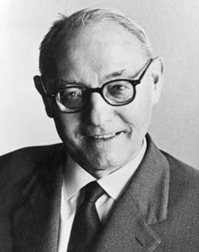
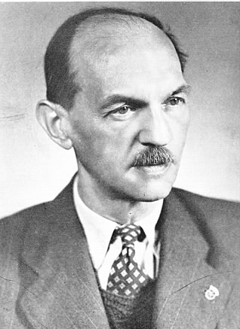
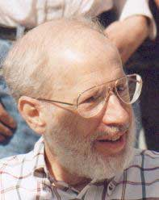
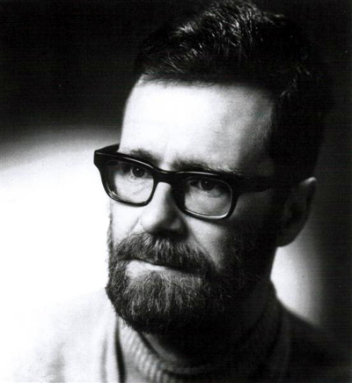
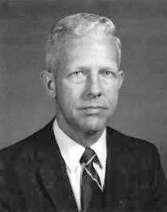
(Old) History of MST algorithms
1920: Otakar Borůvka
1930: Vojtěch Jarník
1956: Kruskal
1957: Prim
1959: Dijkstra

Slide 41
Kruskal’s Algorithm
Input: G=(V,E), c_{e}> 0 for every e in E
T = Ø
Sort edges in increasing order of their cost
Joseph B. Kruskal
Consider edges in sorted order
If an edge can be added to T without adding a cycle then add it to T

Slide 42
Prim’s algorithm
Similar to Dijkstra’s algorithm
2
0.5
1
3
50
51
Robert Prim
2
0.5
Input: G=(V,E), c_{e}> 0 for every e in E
S = {s}, T = Ø
1
50
While S is not the same as V
Among edges e= (u,w) with u in S and w not in S, pick one with minimum cost
Add w to S, e to T

Slide 43
Reverse-Delete Algorithm
2
0.5
1
3
50
51
Input: G=(V,E), c_{e}> 0 for every e in E
2
0.5
T = E
1
3
50
Sort edges in decreasing order of their cost
51
Consider edges in sorted order
If an edge can be removed T without disconnecting T then remove it

Slide 44
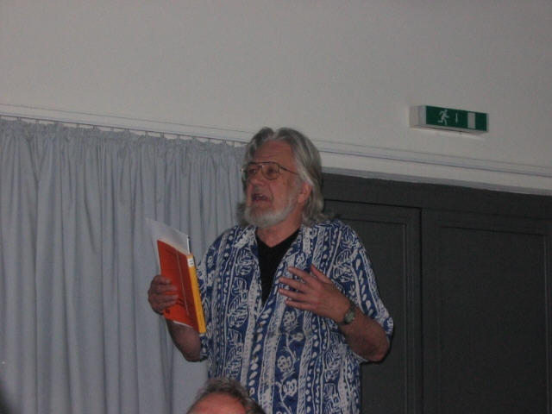
Jack Edmonds

